Slide 1
Myforecast ios APplication
Developed by: Saj Panchal

Slide 2
APPLICATION FEATURES
Gives weather forecast based on your current location.
Updates weather for every 3-hours of interval.
Possible to get weather updates of next 4 days from now.
Easy screen navigation and pleasant UI design.
Shows detailed weather conditions for individual days.
Shows temperature in Celsius and Fahrenheit.
All the data is fetched from 3rd party APIs.

Slide 3
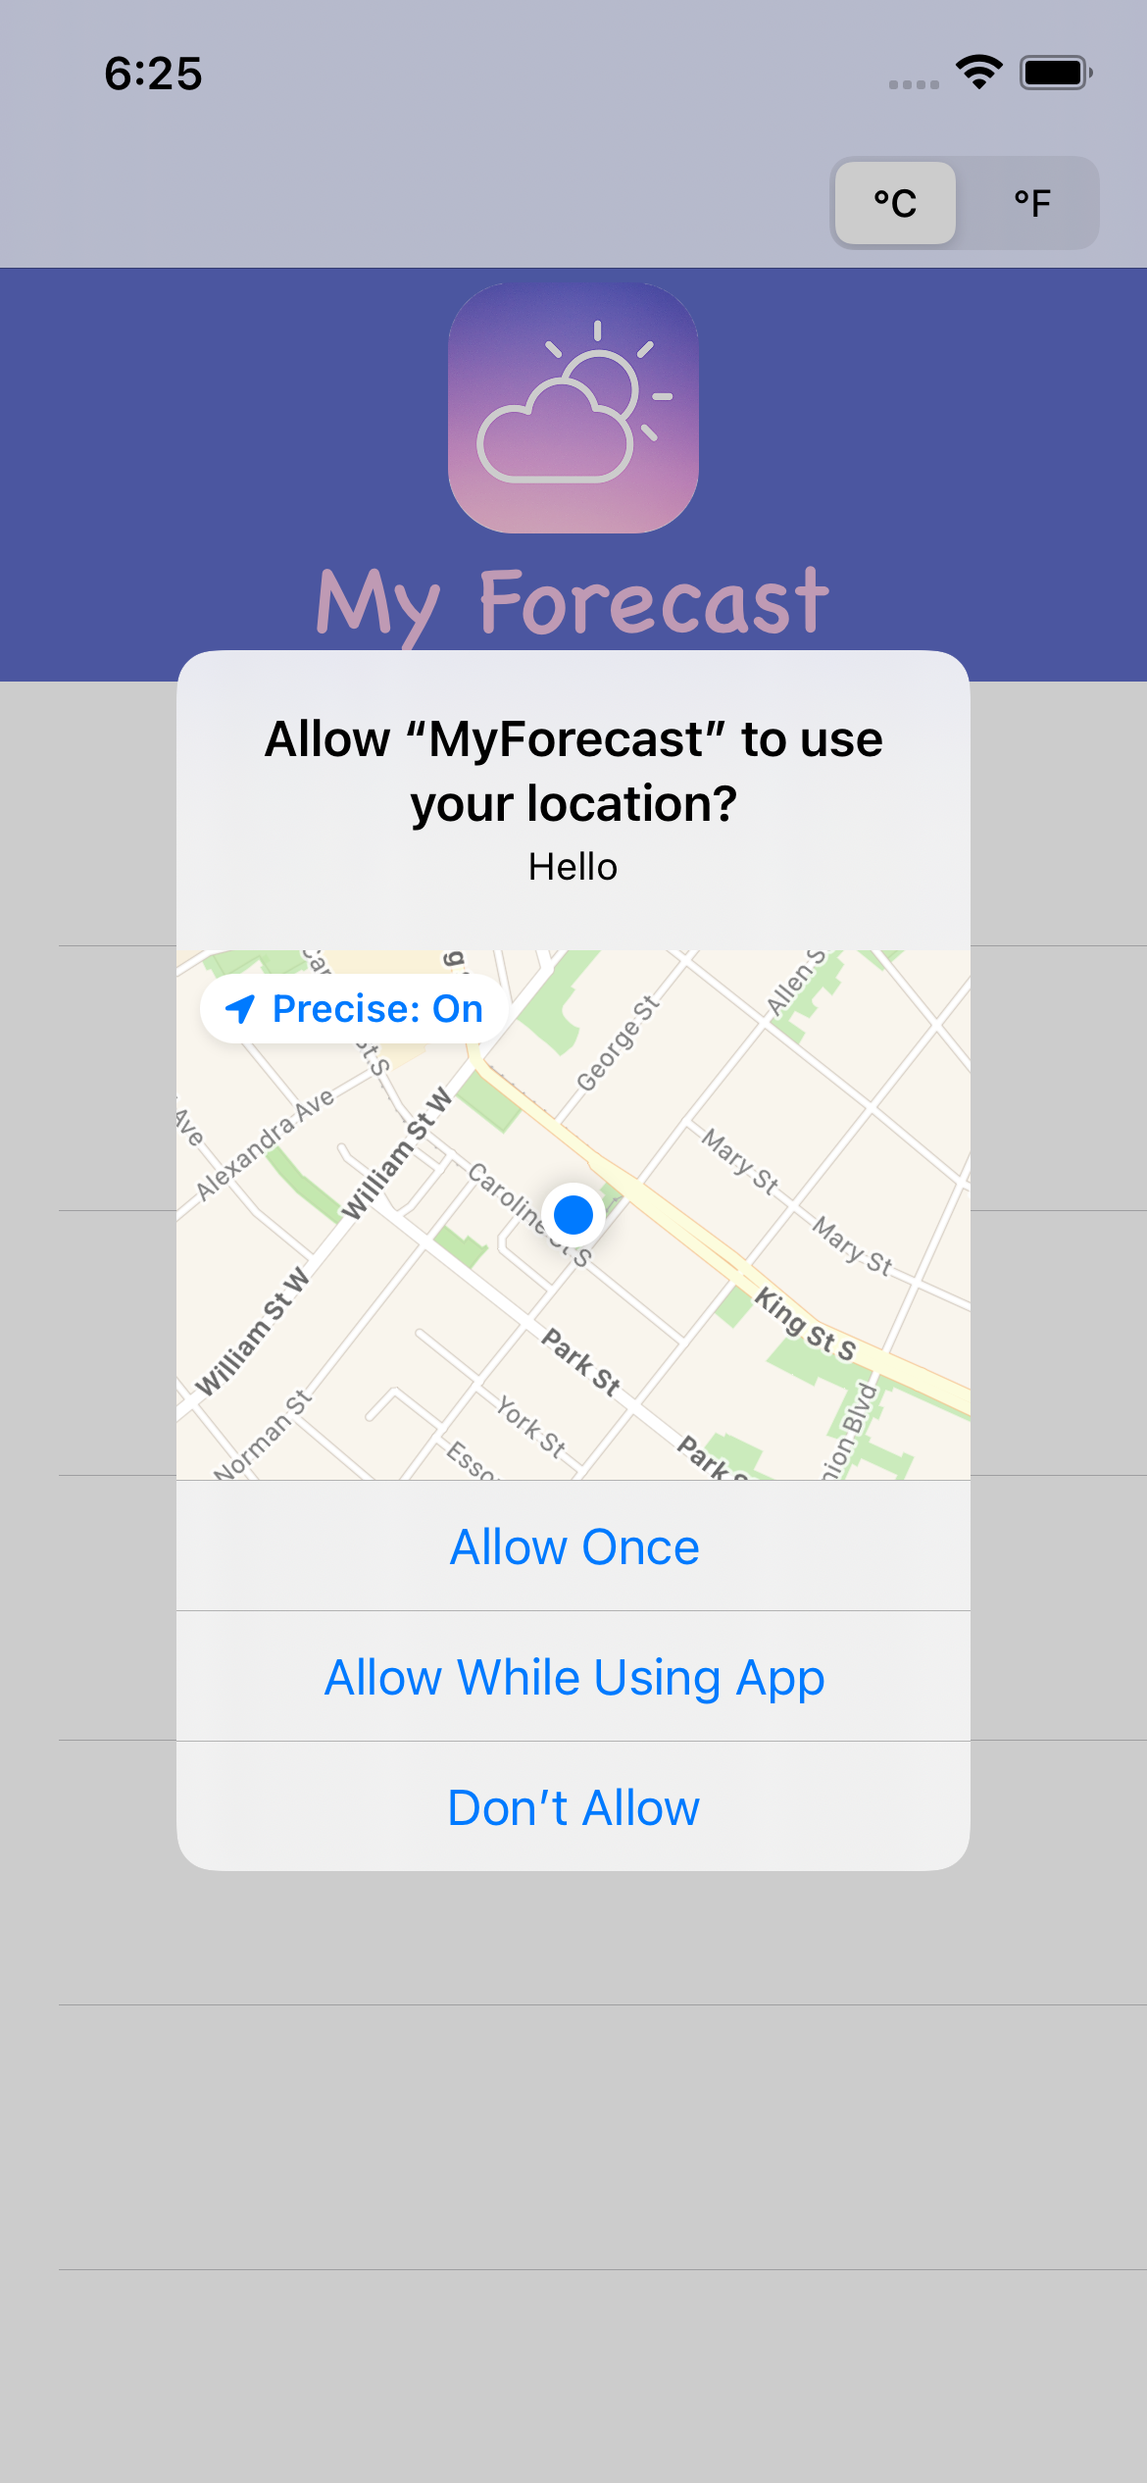
Access Location
The App uses your device geo-coordinates to get weather forecast of your current location.

Slide 4
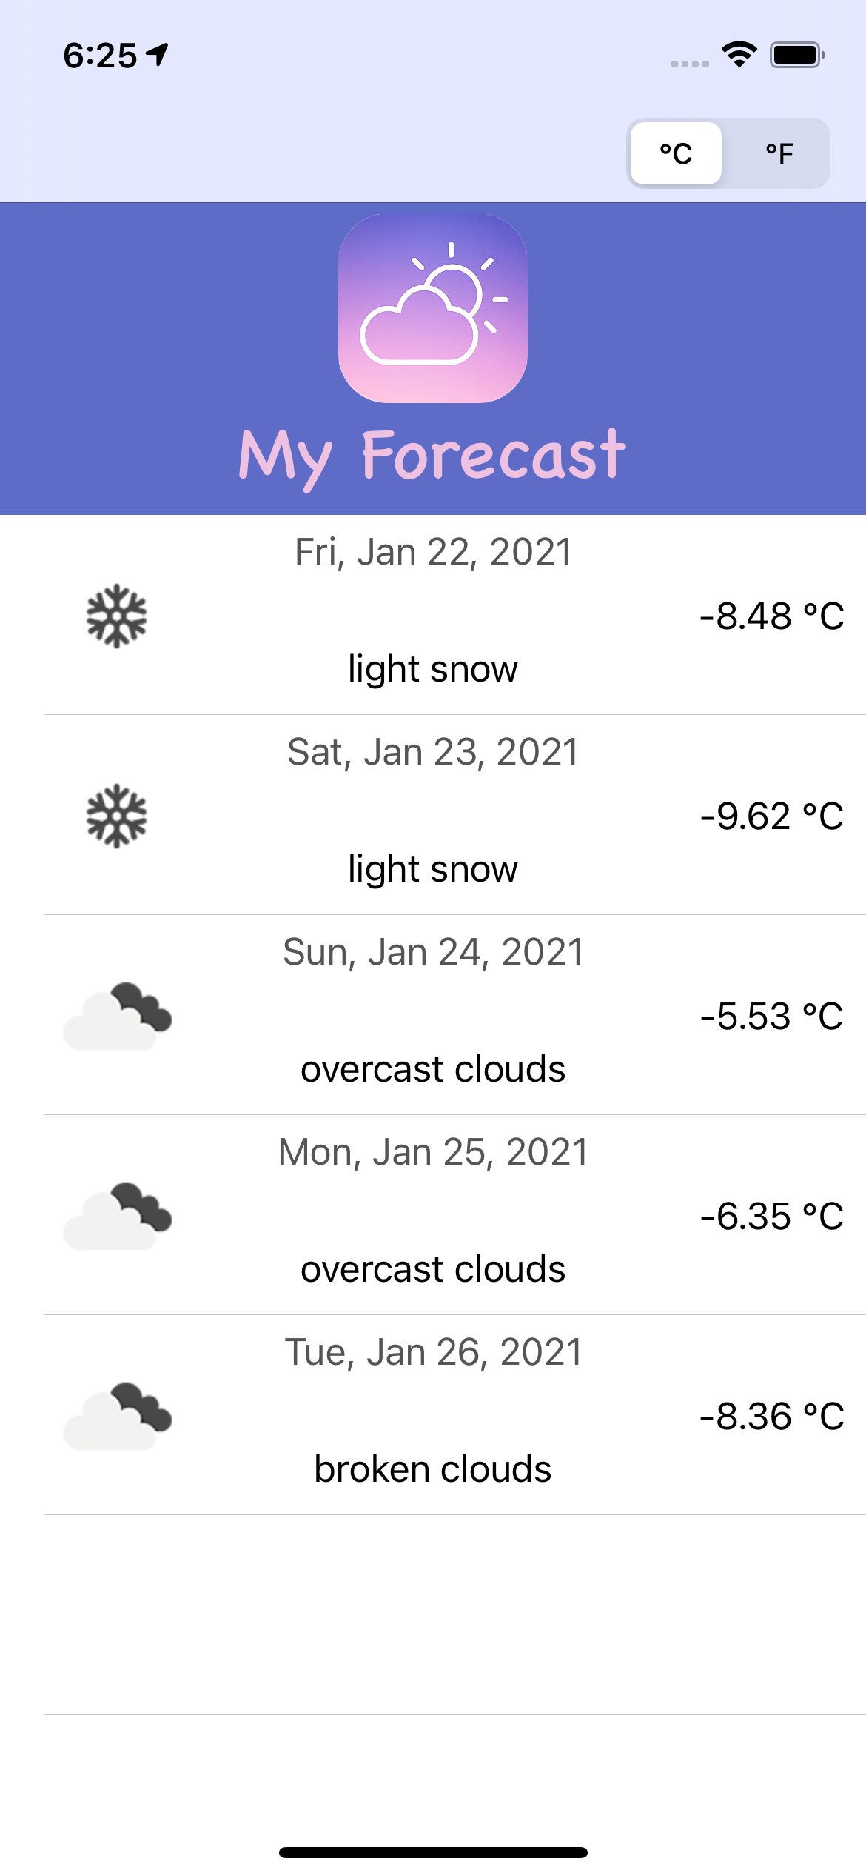
Main screen
There is a segmented control switch that allows user to check the current temperature in Celsius or Fahrenheit.
Table view is utilized to display the 5-day weather forecast.
The table view cell is customized to display date, weather condition text, icon and temperature.

Slide 5
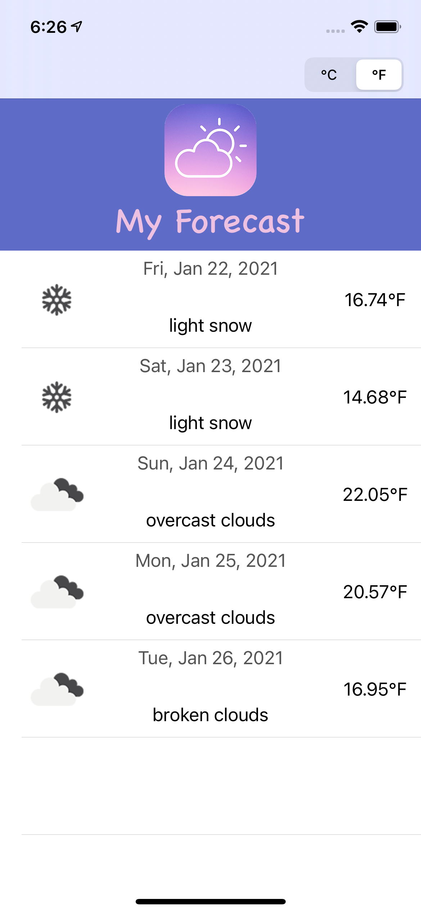
Main screen
There is a segmented control switch that allows user to check the current temperature in Celsius or Fahrenheit.
Table view is utilized to display the 5-day weather forecast.
The table view cell is customized to display date, weather condition text, icon and temperature.

Slide 6
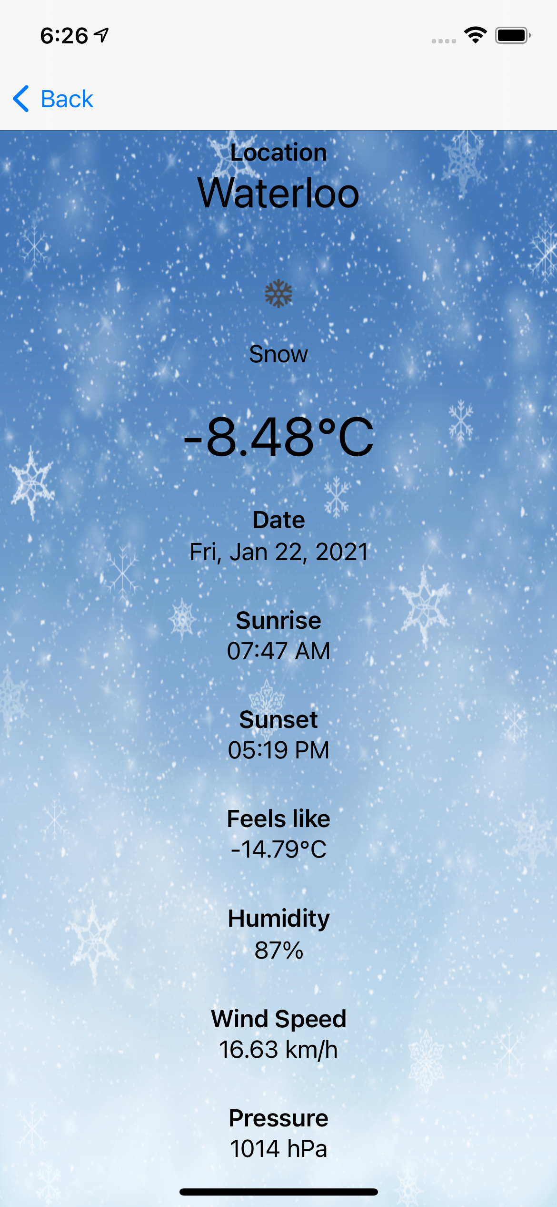
Detailed Weather View
When the user selects a given day from the table, the new screen with detailed weather statistics shows up.
It will include additional weather updates such as sunrise and sunset time, feels like temperature, humidity, wind speed and pressure.
The unit of the measure switches between metric and imperial depending upon the user selection of Celsius or Fahrenheit temperature.
Source: all the API data is fetched from openweathermap.org

Slide 7

Detailed Weather View
When the user selects a given day from the table, the new screen with detailed weather statistics shows up.
It will include additional weather updates such as sunrise and sunset time, feels like temperature, humidity, wind speed and pressure.
The unit of the measure switches between metric and imperial depending upon the user selection of Celsius or Fahrenheit temperature.
Source: all the API data is fetched from openweathermap.org

Slide 8
THANK YOU

